Slide 1


Child-Flourish
Integrated Learning, Emotional Intelligence Platform
Project ID : 24-25J-188

Slide 2
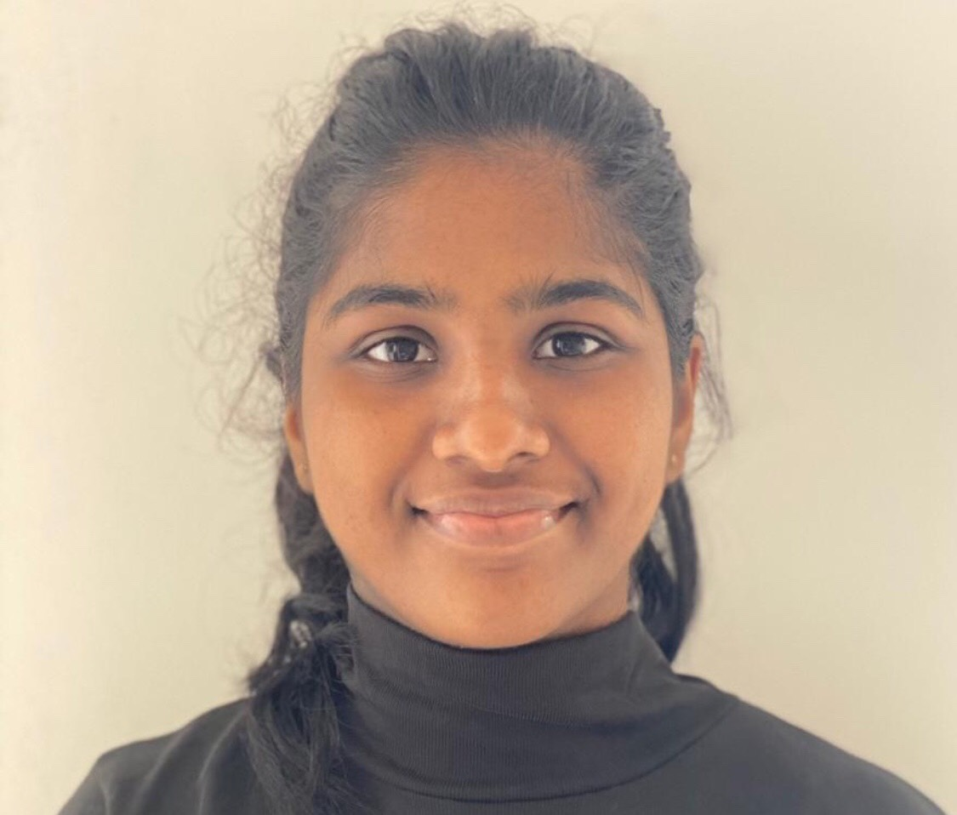


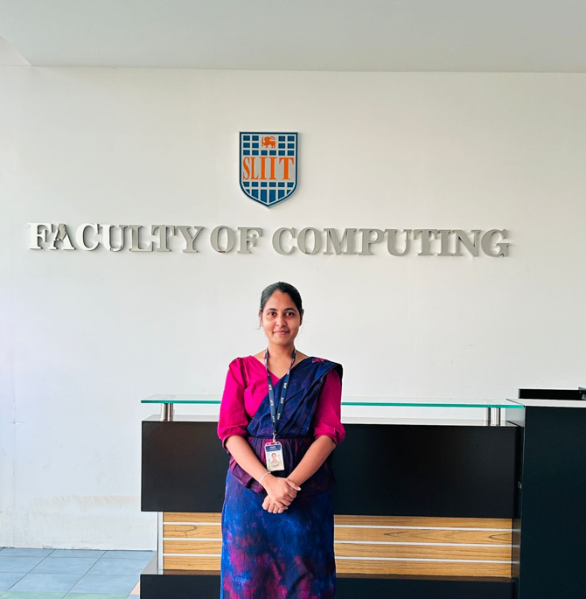

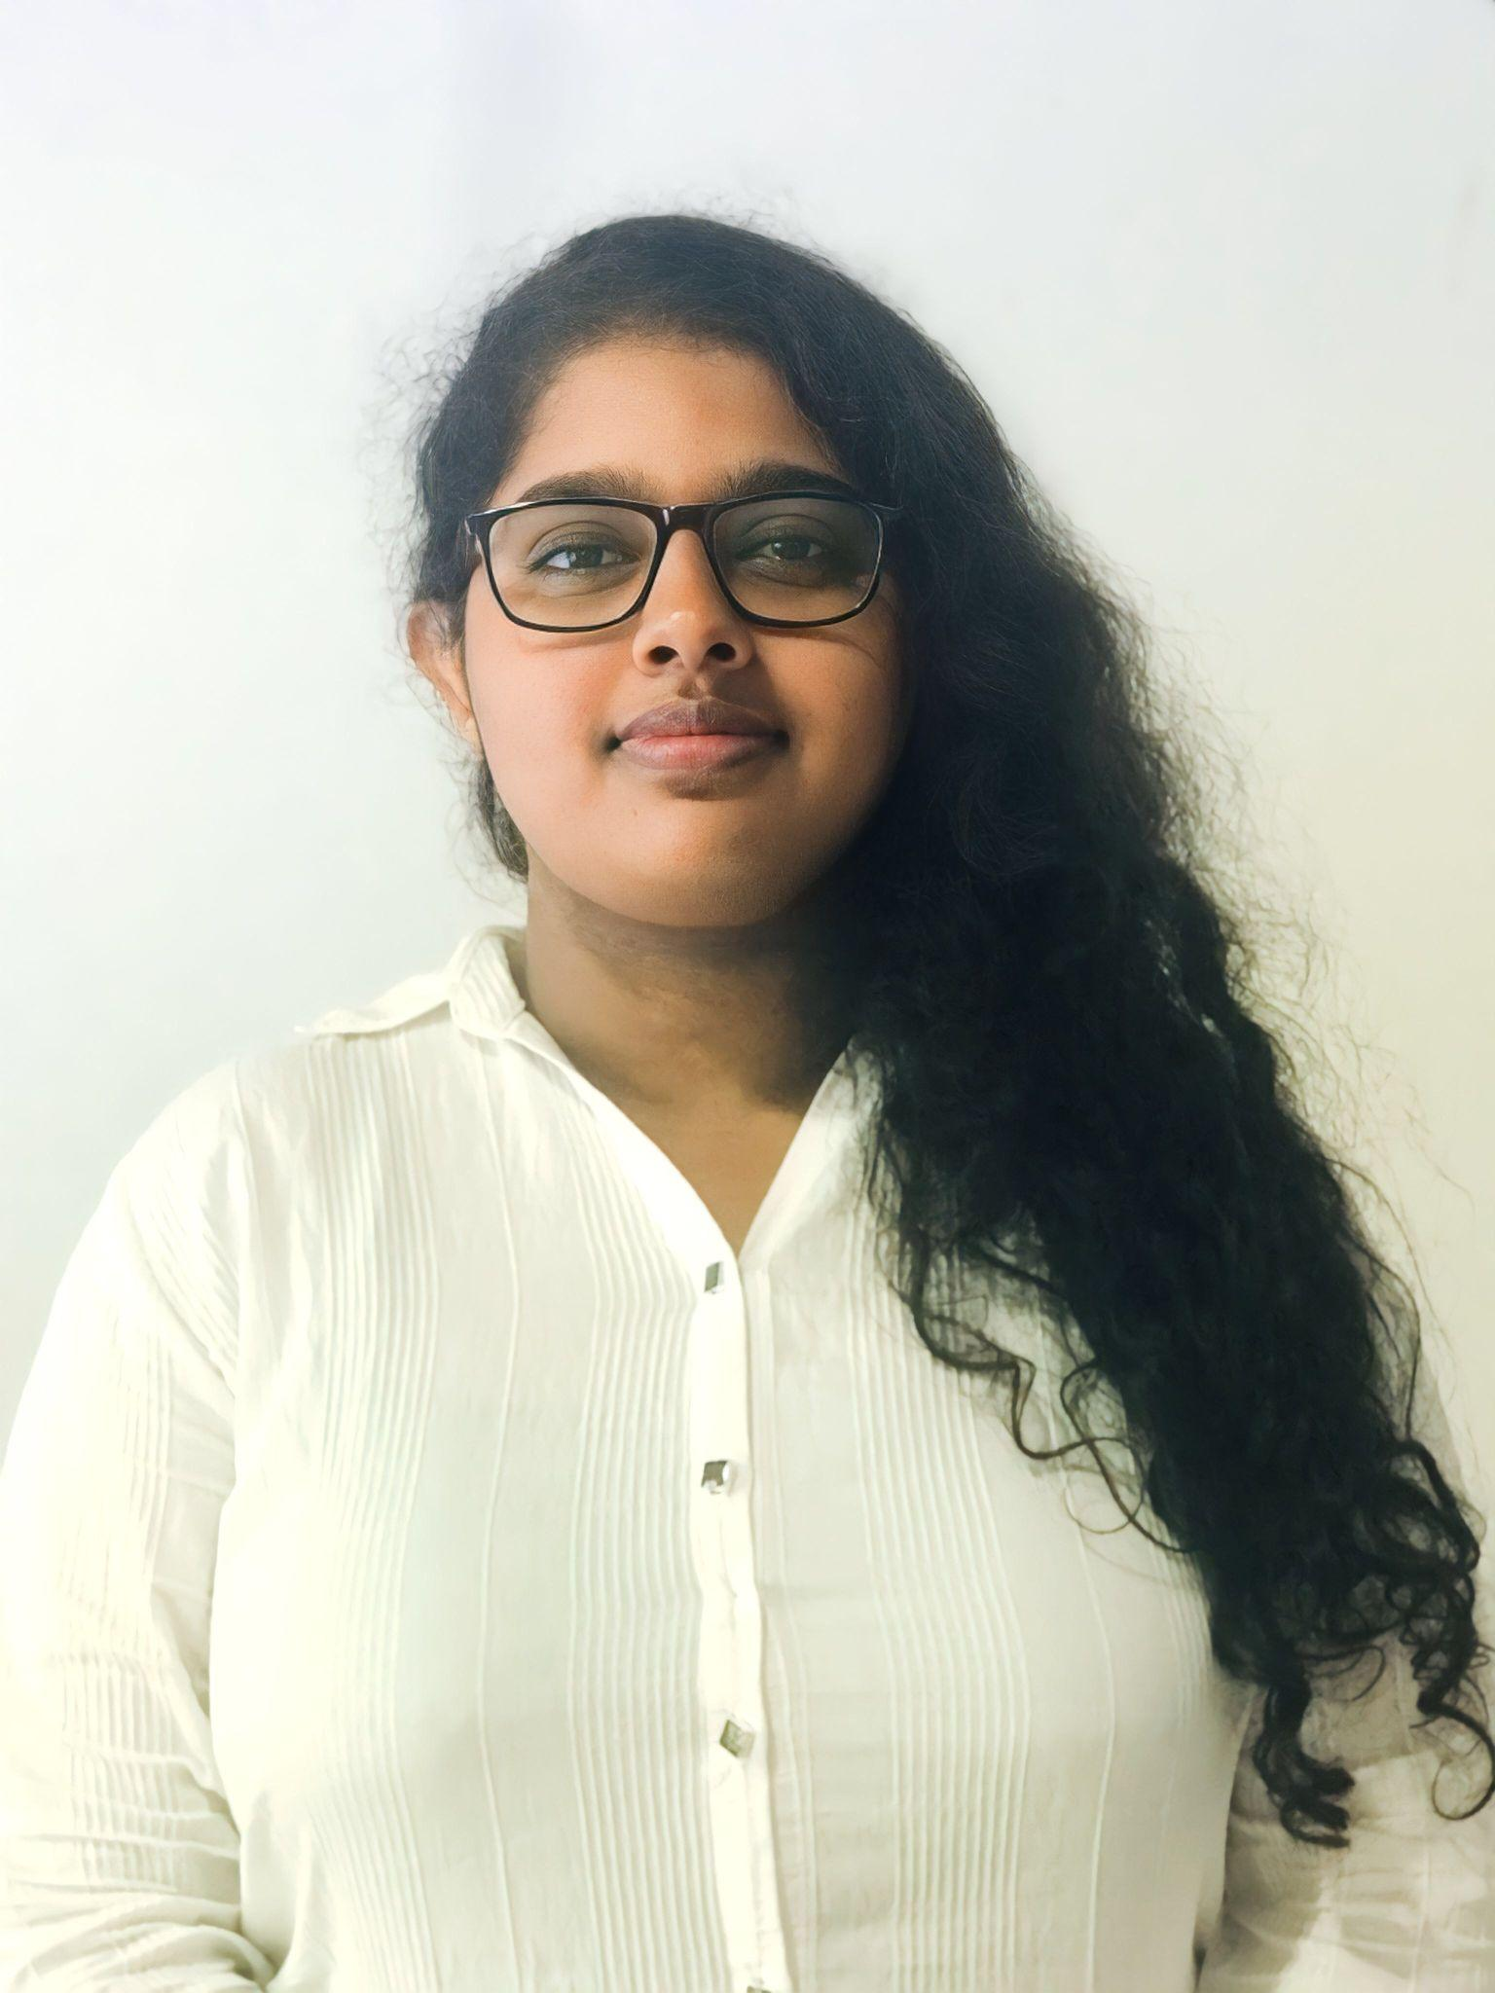



OUR TEAM
Our Team
Ms. Malithi Nawarathne
K.R.K Vidyaratna
IT21295706
LEADER
(+94) 772256676
it21295706@my.sliit.lk
Siriwardana K.D.S.P
IT21293894
(+94) 71 088 8133
it21293894@my.sliit.lk
Prof.Pradeep Abeygunawardhana
SUPERVISOR
Ms. Malithi Nawarathne
CO – SUPERVISOR
Dr.Nilushi Weerapperuma
EXTERNAL SUPERVISOR
Prasadi P.G.K.R
IT21302626
(+94) 70 594 5095
it21302626@my.sliit.lk
Dulangi G.K.N
IT21277290
(+94) 77 0431140
it21277290@my.sliit.lk

Slide 3

Background
In Sri Lanka, parents face difficulties balancing work responsibilities with the time required for their children’s early education and development.
The need for improved methods to identify and support children with Autism Spectrum Disorder (ASD) and ADHD.
There is a growing recognition of the need for innovative educational tools that enhance literacy and cognitive development.
Sri Lankan parents would benefit from flexible, adaptive educational solutions that address both developmental and educational needs.

Slide 4
Research Problem
Parents often struggle to balance work with their children's early education and development, especially for kids aged 8 to 11, a crucial period for social, emotional, and cognitive growth.

Slide 5
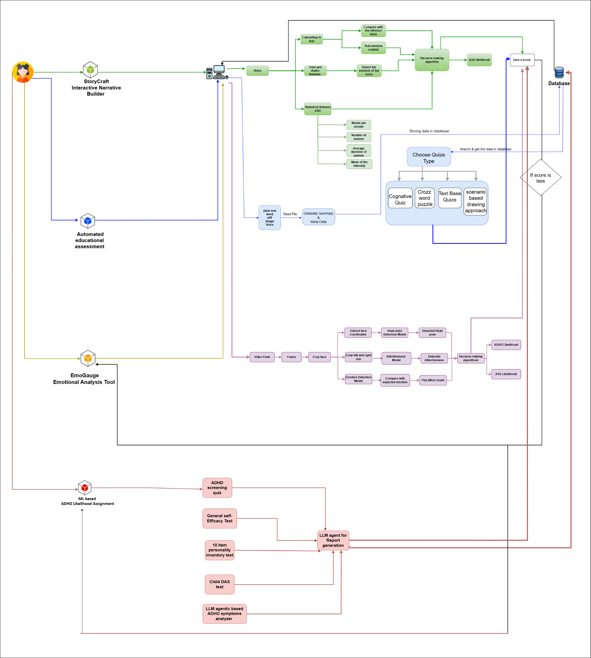
System Overview

Slide 6

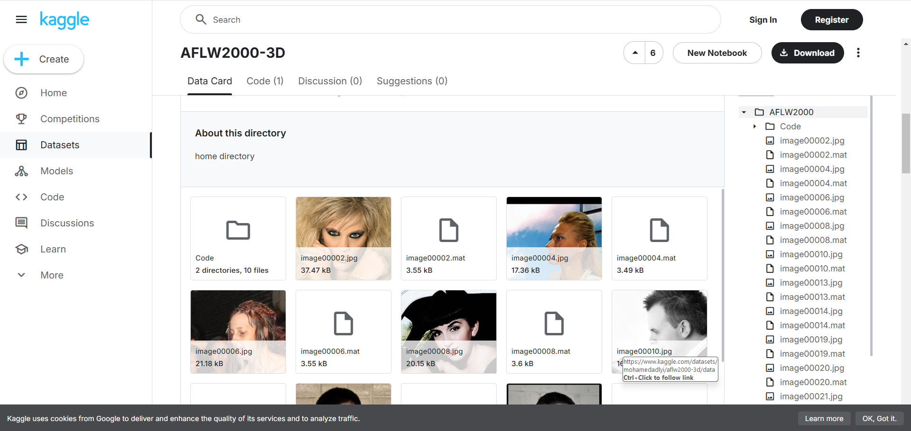
Data Collection
DAS scales
https://www.kaggle.com/datasets/lucasgreenwell/depression-anxiety-stress-scales-responses
Face Coordinates
https://www.kaggle.com/datasets/mohamedadlyi/aflw2000-3d/data

Slide 7
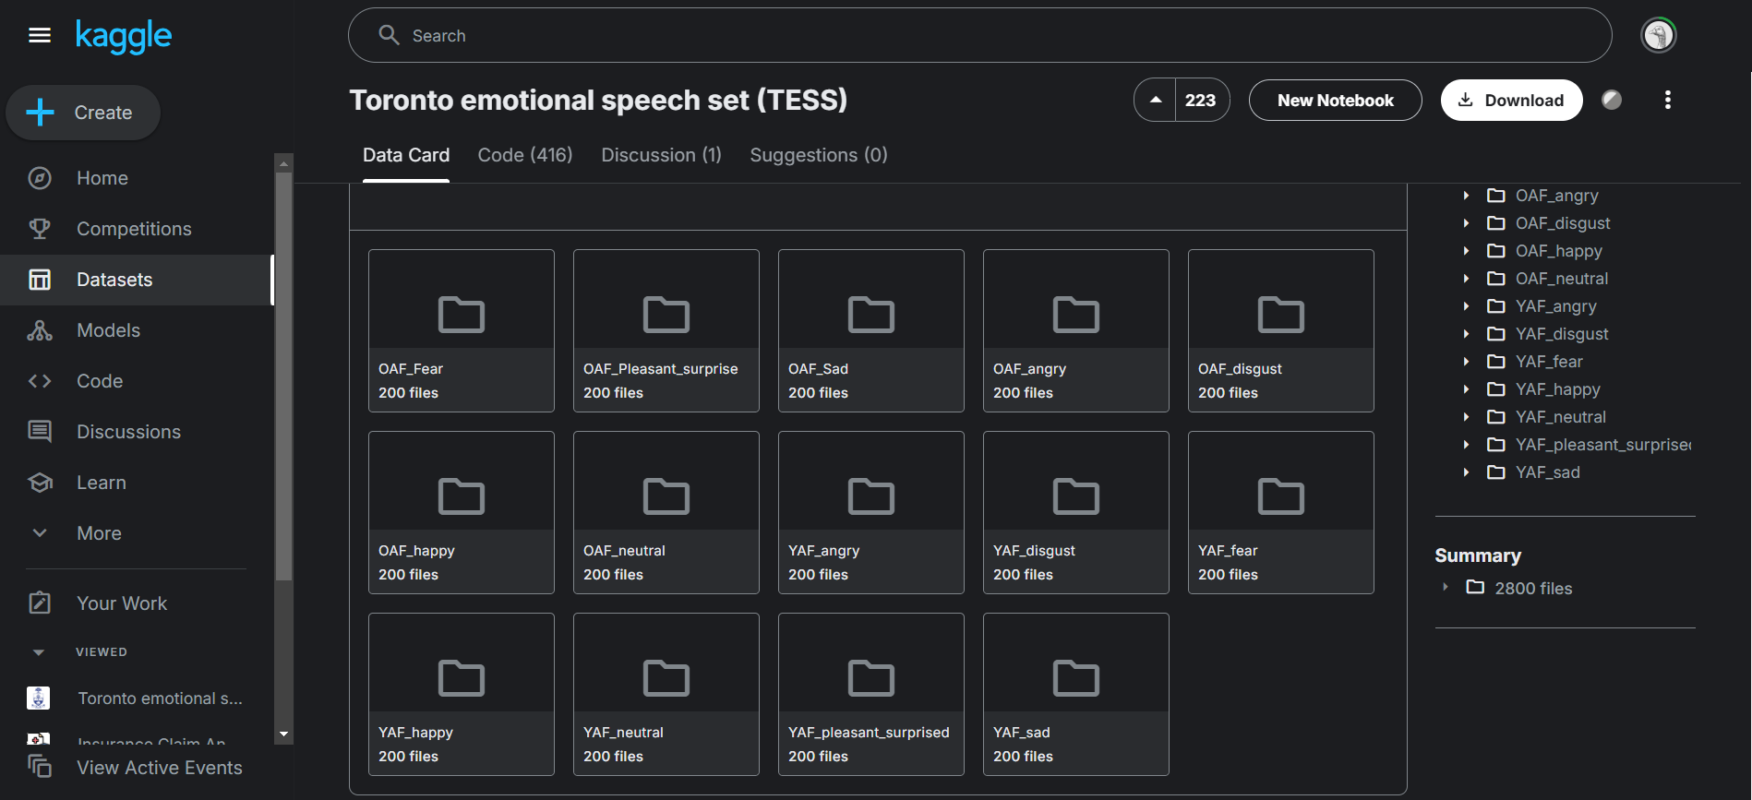

Data Collection
Automated Educational Assessment System for Cognitive Development
https://www.kaggle.com/datasets/ashishjangra27/doodle-dataset
Interactive Narrative Builder (StoryCraft)
https://www.kaggle.com/datasets/ejlok1/toronto-emotional-speech-set-tess

Slide 8
Risk Mitigation
Risk | Risk Mitigation
Limited datasets ( Data Availability) | Use GANs for synthetic data, validate with experts, and apply augmentation
Handling diverse users and large workloads (Scalability) | Use cloud infrastructure, multi-language support, and Colab GPU for scaling prototypes

Slide 9
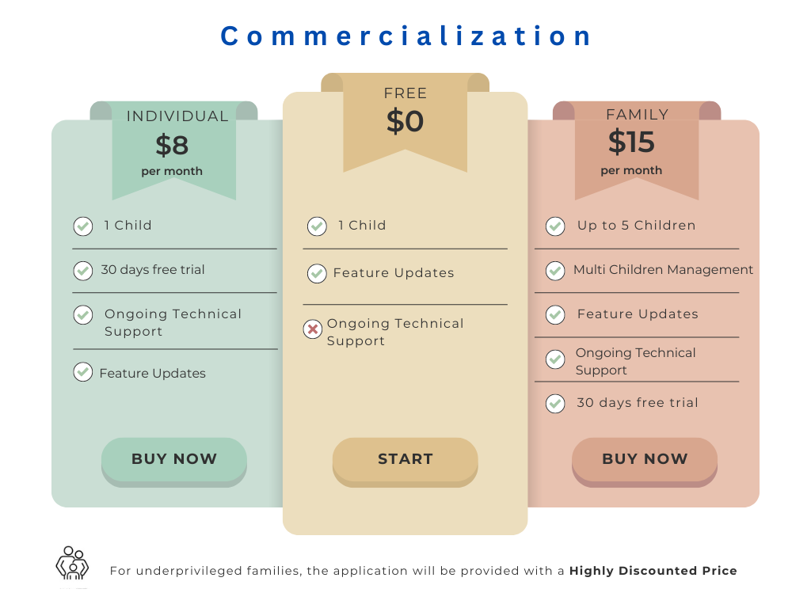

Slide 10
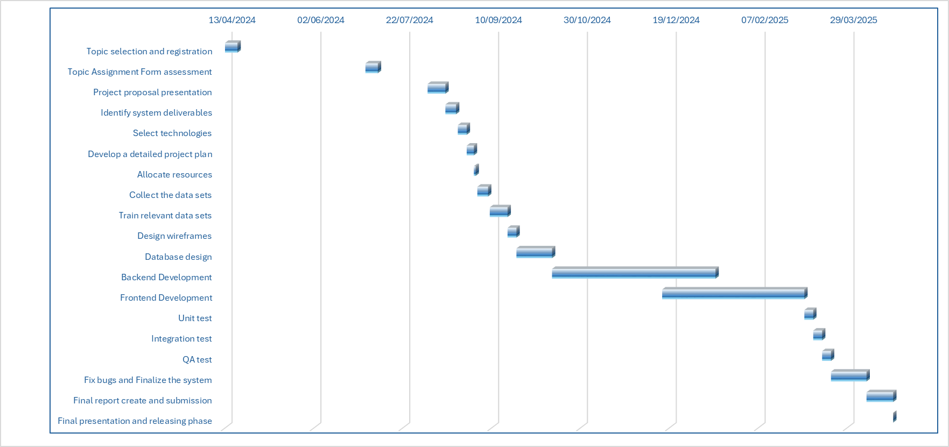
Gantt Chart
IT21302626 | Prasadi P.G.K.R | 24-25J-188

Slide 11

Individual Components

Slide 12
Component 1
ML based ADHD Likelihood Assignment
IT21295706
K.R.K Vidyaratna
Information Technology

Slide 13

Introduction
Early detection of ADHD in children is crucial for timely intervention
Traditional diagnosis methods are time-consuming and often subjective.
Goal is to utilize machine learning to predict the likelihood of ADHD based on behavioral data.
IT21295706 | Vidyaratna K.R.K | 24-25J-188

Slide 14
Research Gap
Features | A Gamified Learning Tool for Sri Lankan Primary Schools [1] | Applying machine learning to optimize the predictive model [2] | Child-Flourish
Data Collection Comprehensive surveys for parents to gather relevant behavioral data | X | X | ✔
Early Detection Identifies children at risk of ADHD early by analyzing behavioral data. | ✔ | ✔ | ✔
Personalized Inputs Allow parents to provide additional textual descriptions of the child's behavior, if received score is lower | X | X | ✔
Model Development Machine learning models trained on prepared datasets to predict ADHD likelihood. | X | ✔ | ✔
Novelty
Innovative Data Augmentation
Holistic Assessment Approach
Enhanced Accuracy
IT21295706 | Vidyaratna K.R.K | 24-25J-188
|

Slide 15
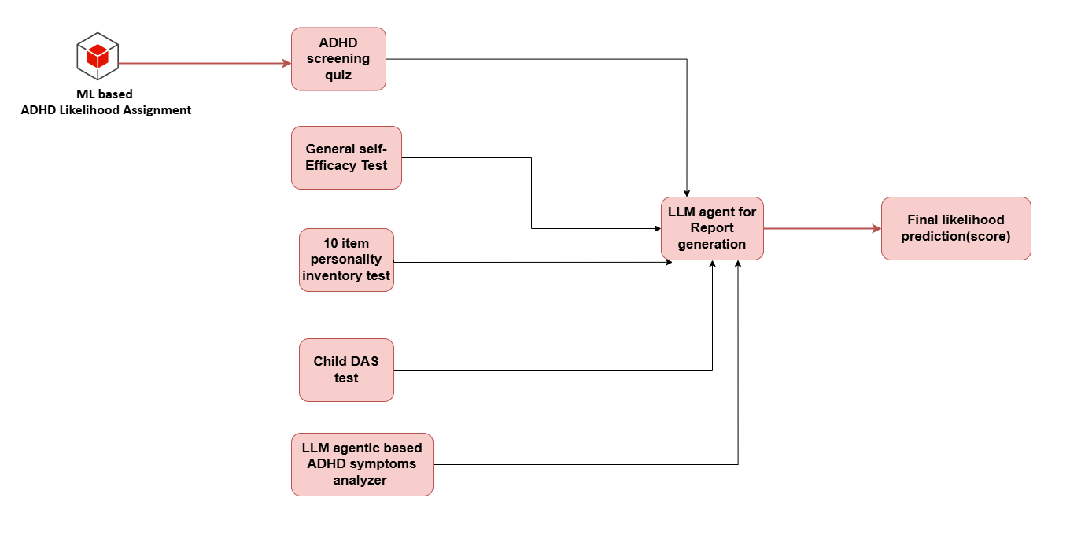
System Diagram
IT21295706 | Vidyaratna K.R.K | 24-25J-188

Slide 16
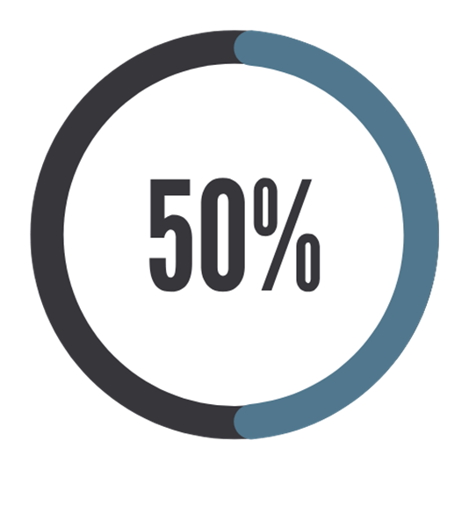


Progress and Deliverables
PP1 PP2
ADHD questionaire based prediction
LLM agentic based ADHD Symptoms analyzer
ML-based self-efficiency test
DASS Prediction(Depression, Stress, Anxitey)
IT21295706 | Vidyaratna K.R.K | 24-25J-188

Slide 17
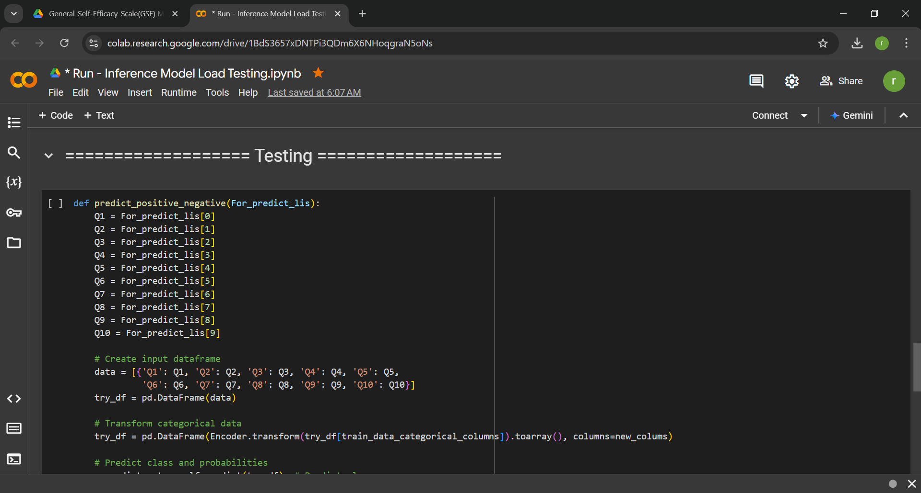
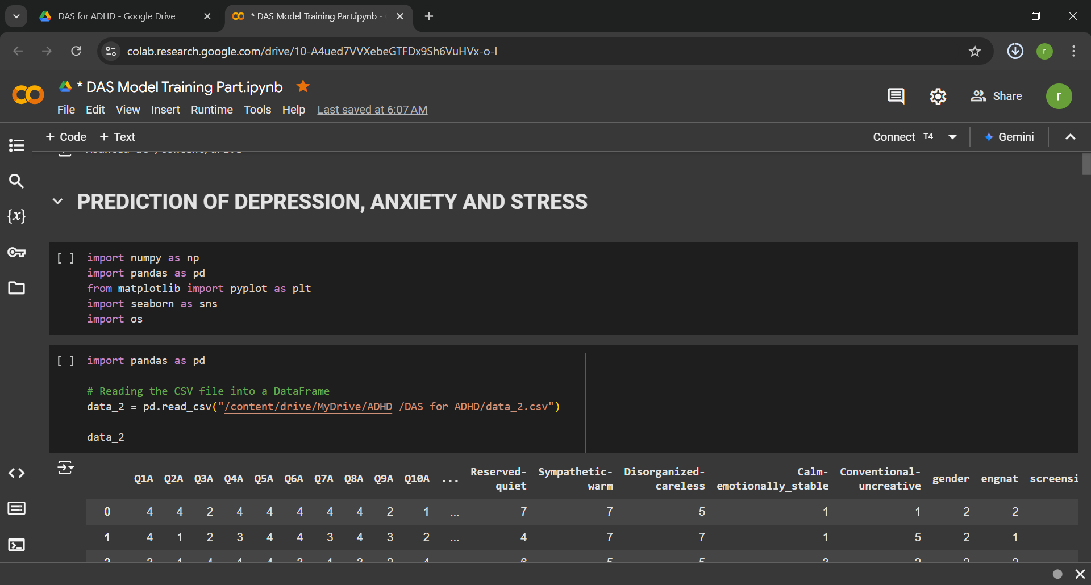
Proof of Concept
General self efficiency test
DAS model tranning
IT21295706 | Vidyaratna K.R.K | 24-25J-188

Slide 18
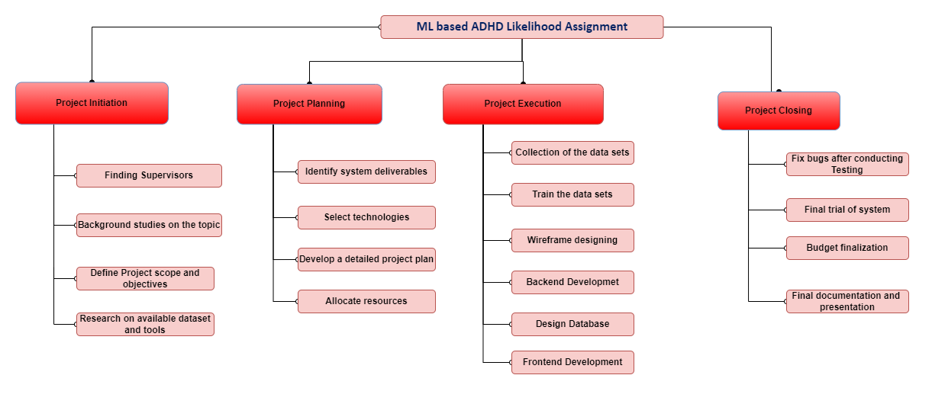
Work Breakdown Structure
IT21295706 | Vidyaratna K.R.K | 24-25J-188

Slide 19
Component 2
Emotional Analysis Tool (EmoGauge)
IT21293894
Siriwardana K.D.S.P
Information Technology

Slide 20
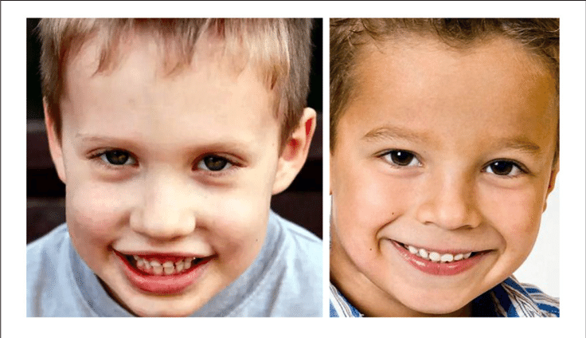

Introduction
Provide an indication of the likelihood of Autism Spectrum Disorder (ASD) by measuring flat affect in children aged 8 to 11.
Flat affect is a symptom where a person doesn't express emotions in the same way as others.
By using an emotion detection approach, facial expressions are analyzed to identify flat affect.
IT21293894 | Siriwardana K.D.S.P | 24-25J-188

Slide 21
Research Gap
Features | Quantifying facial expression - related children with ASD [3] | Facial emotion recognition children with ASD [4] | Child-Flourish
Provides real-time tracking of children's facial expressions to determine their emotional states. | X | X | ✔
Mechanisms to measure children's attentiveness through video monitoring | X | X | ✔
Tracks and evaluates children's facial expressions to determine their emotional states. | ✔ | ✔ | ✔
Uses scenarios and contexts to evaluate children's facial expressions and emotional responses | X | ✔ | ✔
Novelty
Accurately track focus in real time.
Monitor session engagement and enhance the accuracy of flat affect.
Use the flat affect emotion model to detect emotions.
|
IT21293894 | Siriwardana K.D.S.P | 24-25J-188

Slide 22
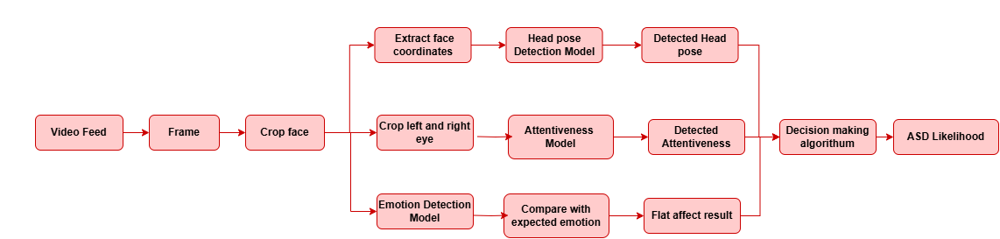
System Diagram
IT21293894 | Siriwardana K.D.S.P | 24-25J-188

Slide 23
Progress and Deliverables
PP1 PP2
Realistic Synthetic Emotion Data Generation for children
Development of Flat Affect Detection Approach
Integration
Final Report Generation
Head Pose Detection Model
Attentiveness Detection Model
In-Progress Task
Emotion Detection Model
IT21293894 | Siriwardana K.D.S.P | 24-25J-188

Slide 24
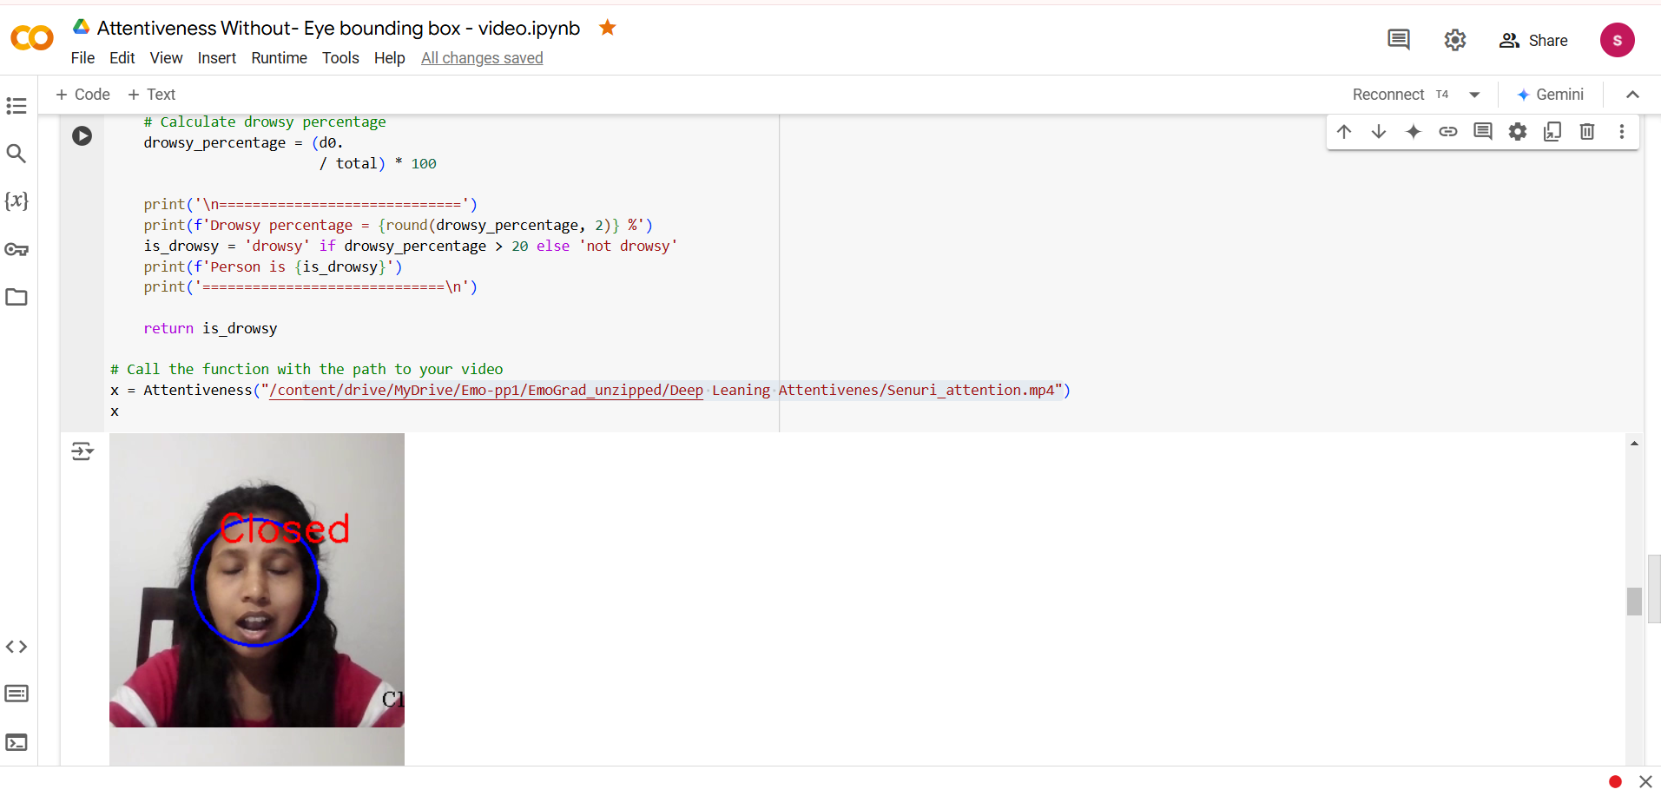
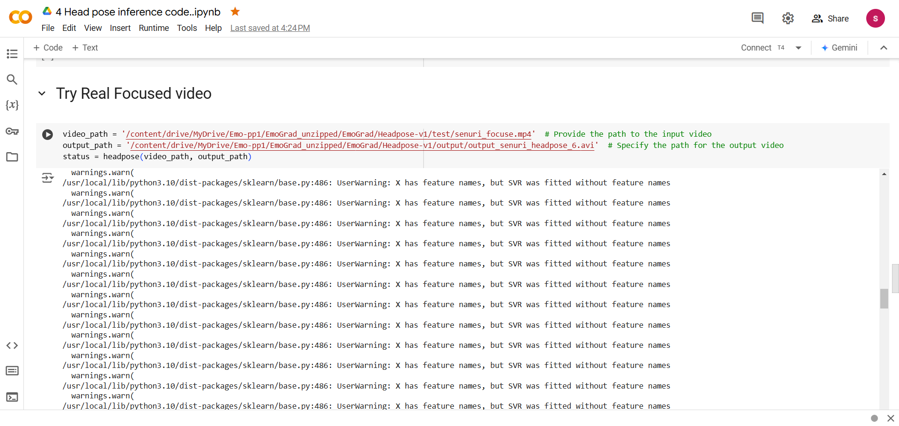
Proof of Concept
Test attentiveness Model
Test real focused video for Head Pose
IT21293894 | Siriwardana K.D.S.P | 24-25J-188

Slide 25
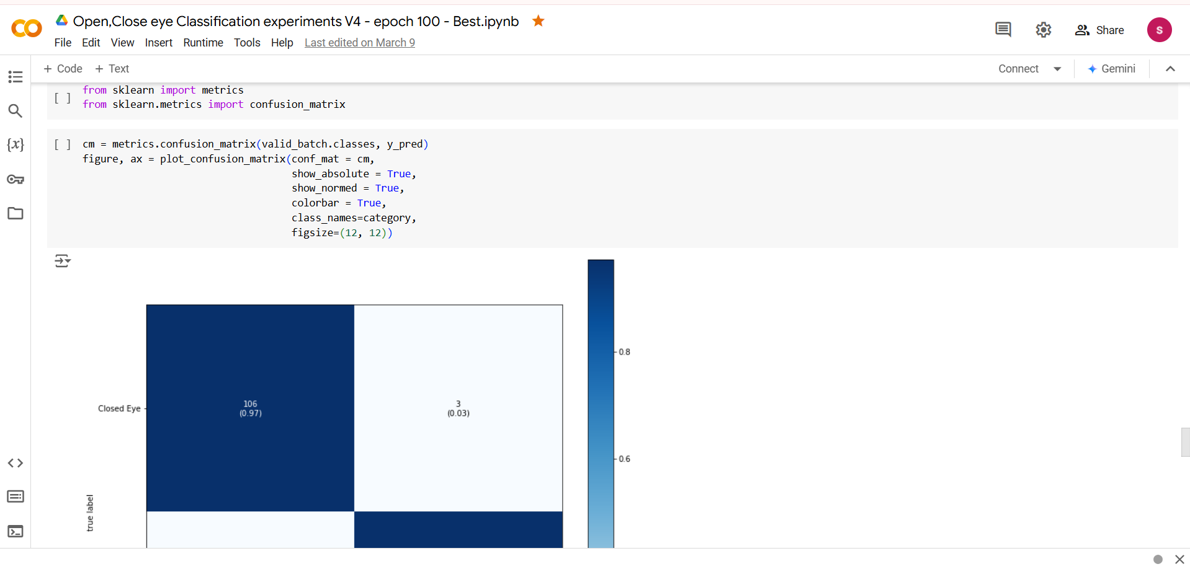
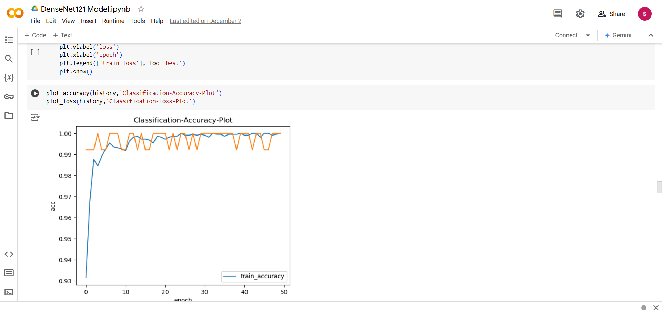
Proof of Concept
Model Confusion Metrics
Accuracy of our model on train data
IT21293894 | Siriwardana K.D.S.P | 24-25J-188

Slide 26
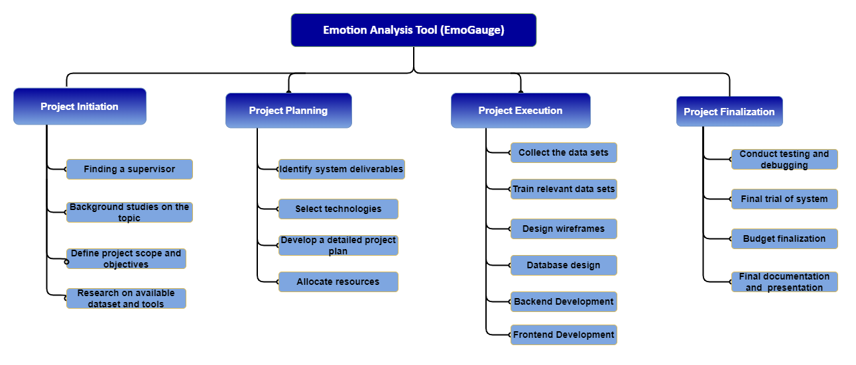
Work Breakdown Structure
IT21293894 | Siriwardana K.D.S.P | 24-25J-188

Slide 27
Component 3
Interactive Narrative Builder (StoryCraft)
IT21302626
Prasadi P.G.K.R
Information Technology

Slide 28
Introduction
Utilizes voice-based storytelling to assess children's cognitive development through their narration.
Analyzes speech features and emotional context to evaluate children's narrative abilities, emotional responses, and flat affect, which is commonly observed in individuals with Autism Spectrum Disorder (ASD).
Designed for children aged 8 to 11, it supports educational development by enhancing their narrative and communication skills.
IT21302626 | Prasadi P.G.K.R | 24-25J-188

Slide 29
Research Gap
Features | Nature-Based Early Childhood Education and Children’s Social, Emotional, and Cognitive Development: A Mixed-Methods Systematic Review [5] | Automatic Detection of Autism Spectrum Disorder in Children Using Acoustic and Text Features from Brief Natural Conversations [6] | Child-Flourish
Cognitive development through storytelling | ✔ | X | ✔
Speech-to-text and voice emotion recognition | X | ✔ | ✔
Detection of ASD using advanced analysis | X | ✔ | ✔
Integration of storytelling, likelihood, and education | ✔ | X | ✔
Novelty
Integration of Cognitive and Emotional Assessment
Speech Feature Analysis for ASD likelihood
Real-Time Story Comparison with Reference Stories.
Voice Emotion Analysis in Storytelling Contex (Flat affect)
|
IT21302626 | Prasadi P.G.K.R | 24-25J-188

Slide 30
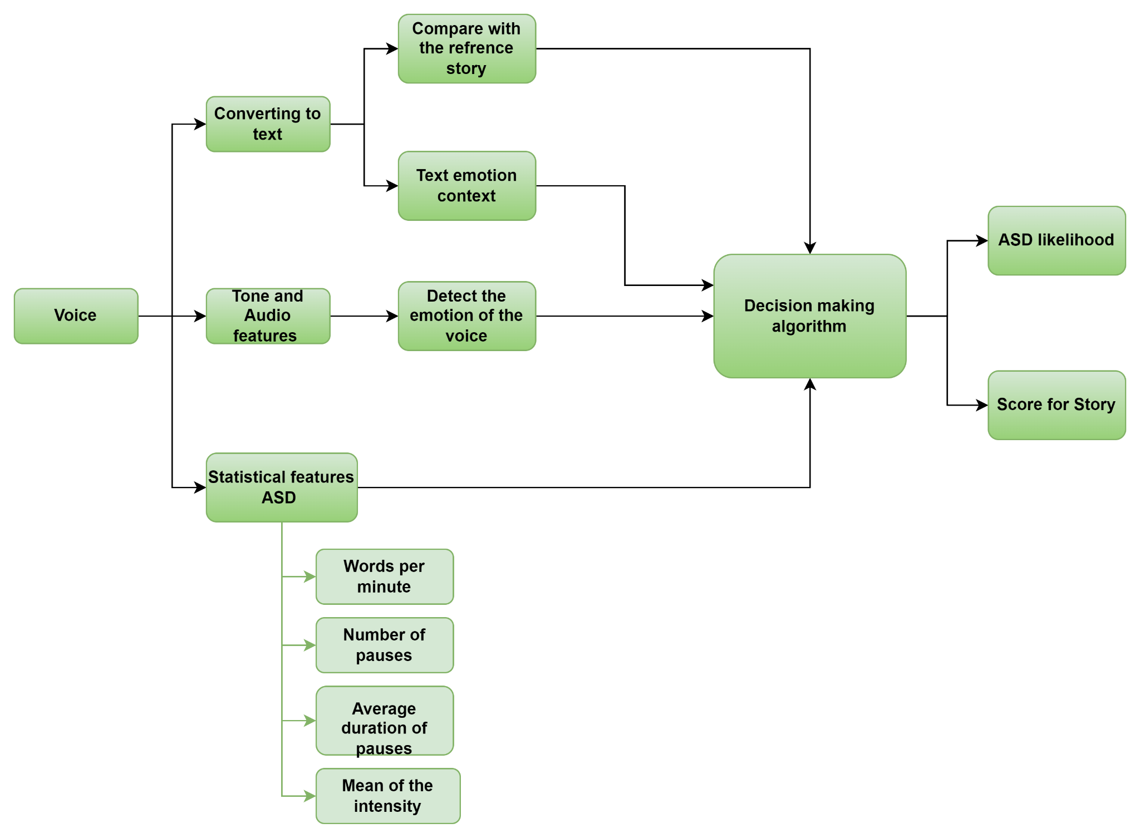
System Diagram
IT21302626 | Prasadi P.G.K.R | 24-25J-188

Slide 31
Progress and Deliverables
PP1 PP2
Voice to Text Conversion
Text-Based Story Analysis Compared with Original Story
Text Content Emotional Detection
Decision-Making Algorithm
Voice Emotion Classification (6 - class Classification and 3 - class Classification)
Statistical Approach for ASD detection
IT21277290 | Dulangi G.K.N | 24-25J-188

Slide 32
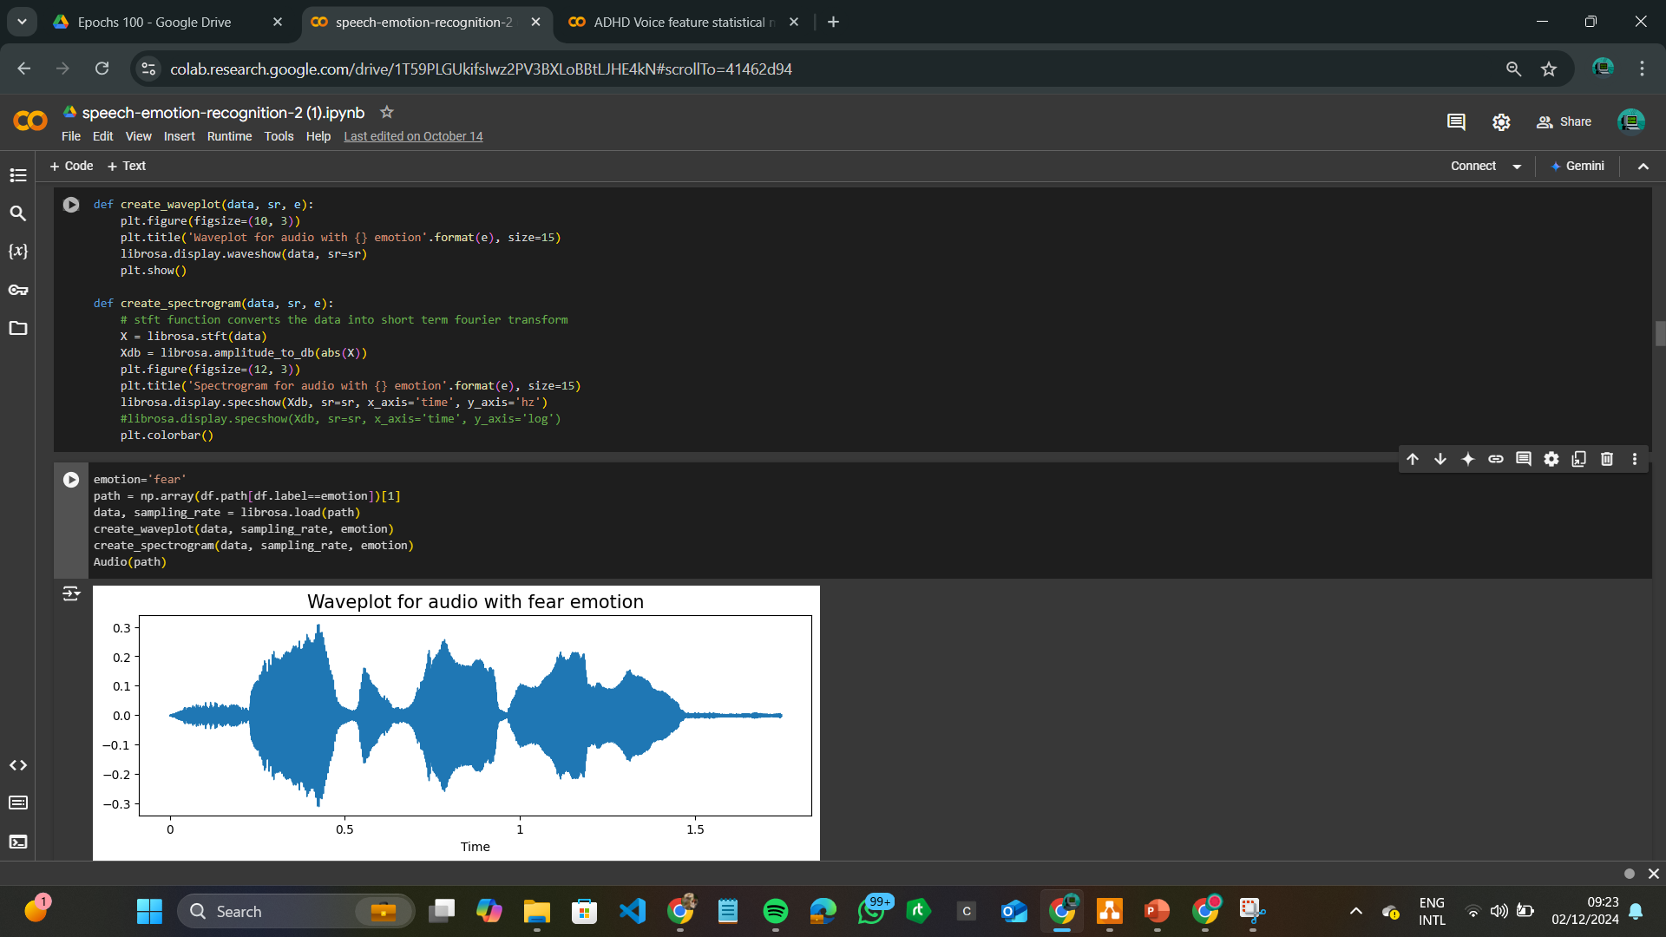
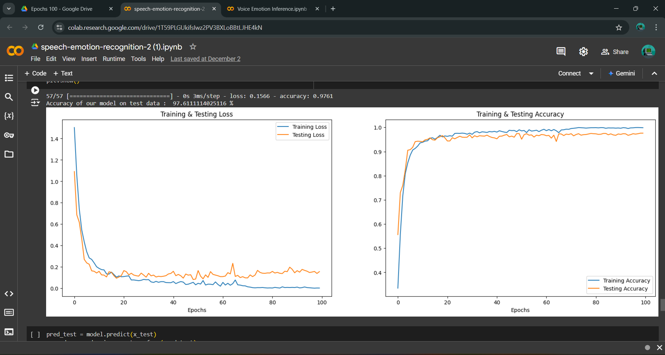
Proof of Concept
Speech emotion wave plotting
Accuracy of our model on train & test data
IT21302626 | Prasadi P.G.K.R | 24-25J-188

Slide 33
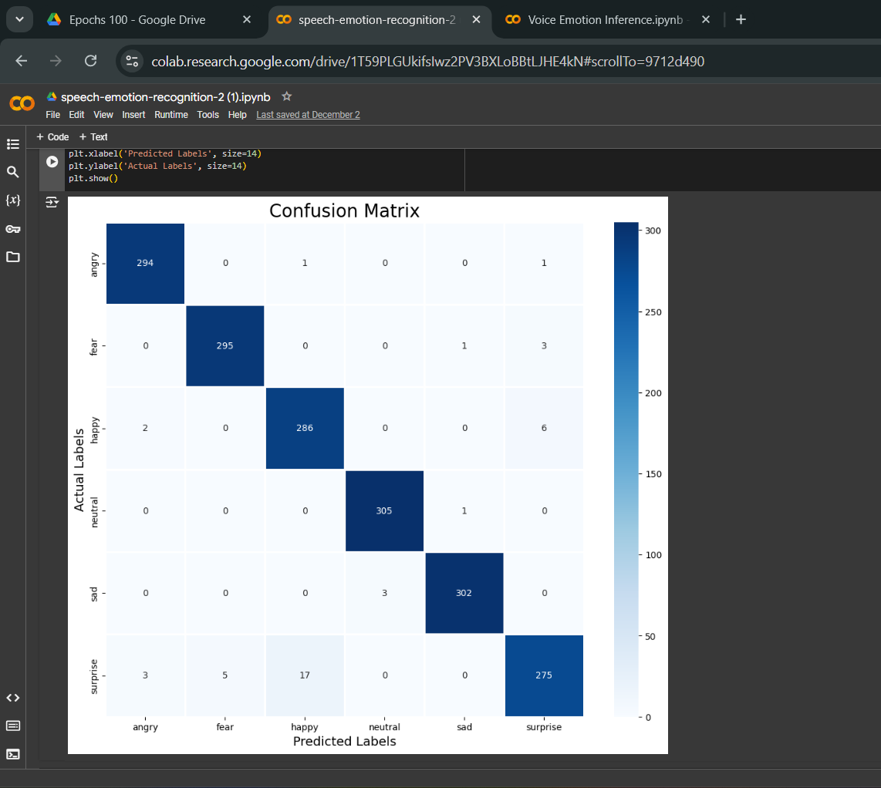
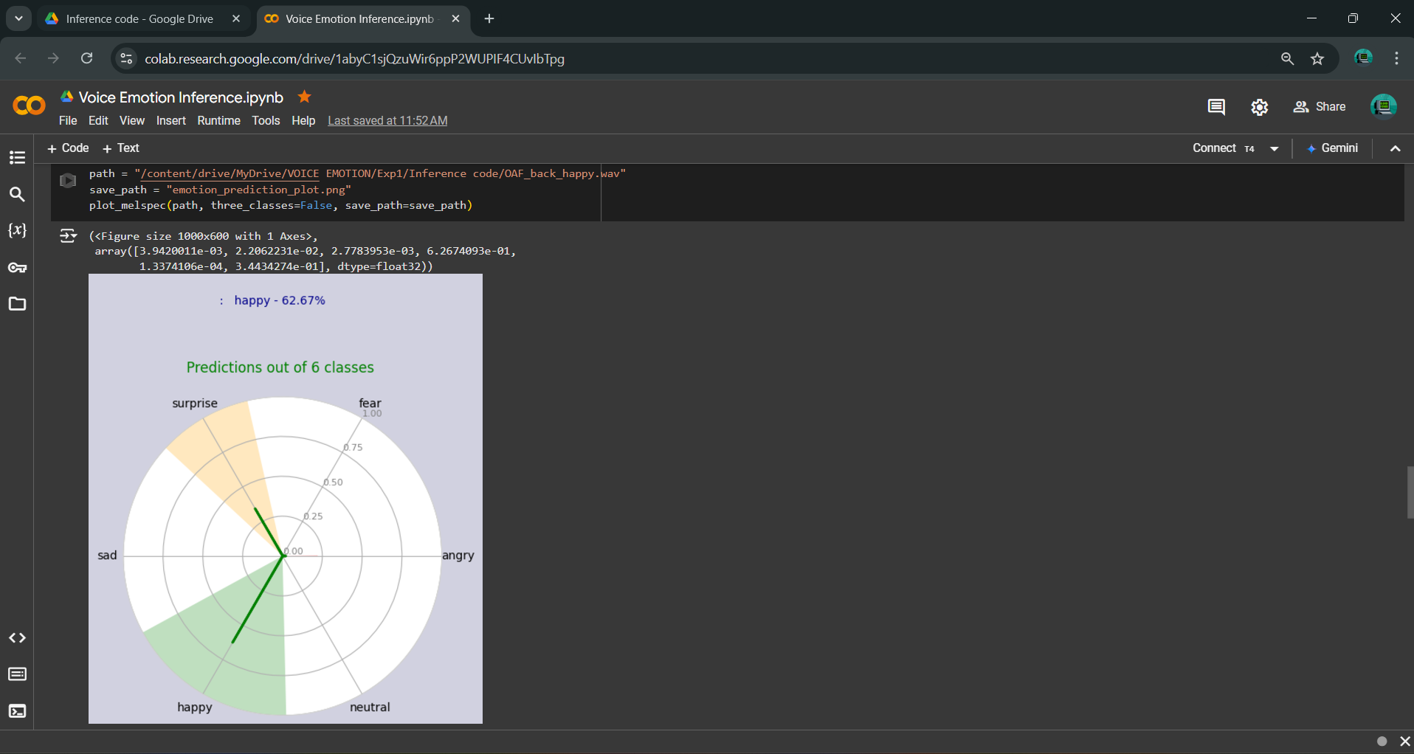
Proof of Concept
Model Performance Metrics
Voice Emotions Detection Results
IT21302626 | Prasadi P.G.K.R | 24-25J-188

Slide 34
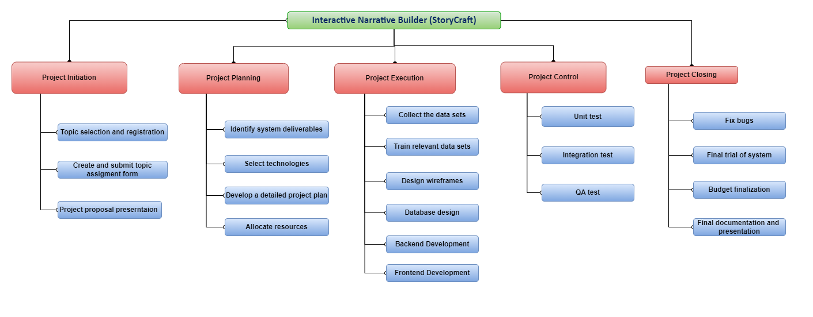
Work Breakdown Structure
IT21302626 | Prasadi P.G.K.R | 24-25J-188

Slide 35

Component 4
Automated Educational Assessment System for Cognitive Development
IT21277290
Dulangi G.K.N
Information Technology

Slide 36
Introduction
This is focusing on enhancing children’s learning through personalized assessments while also identifying potential cognitive and emotional challenges like ADHD , ADD likelihood
IT21277290 | Dulangi G.K.N | 24-25J-188

Slide 37
Research Gap
Features | Implementation and assessment of the automatic question generation module | A Question Generation Engine for Educational Assesment Based on Domain Ontologies | Child-Flourish
generates personalized questions tailored to each child's individual learning needs, ensuring a unique and customized assessment experience. | X | X | ✔
Incorporates Retrieval Augmented Generation (RAG) for personalized question generation. | X | X | ✔
Automatically generate relevant and challenging questions, adapting to the child's progress and learning level. | ✔ | ✔ | ✔
Calculate a score and Real time feedback | X | X | ✔
Novelty
Retrieval Augmented Generation (RAG)
Pre-trained Large Language Model
Dynamic Question Variation
Comprehensive and Fair Assessment
IT21277290 | Dulangi G.K.N | 24-25J-188

Slide 38
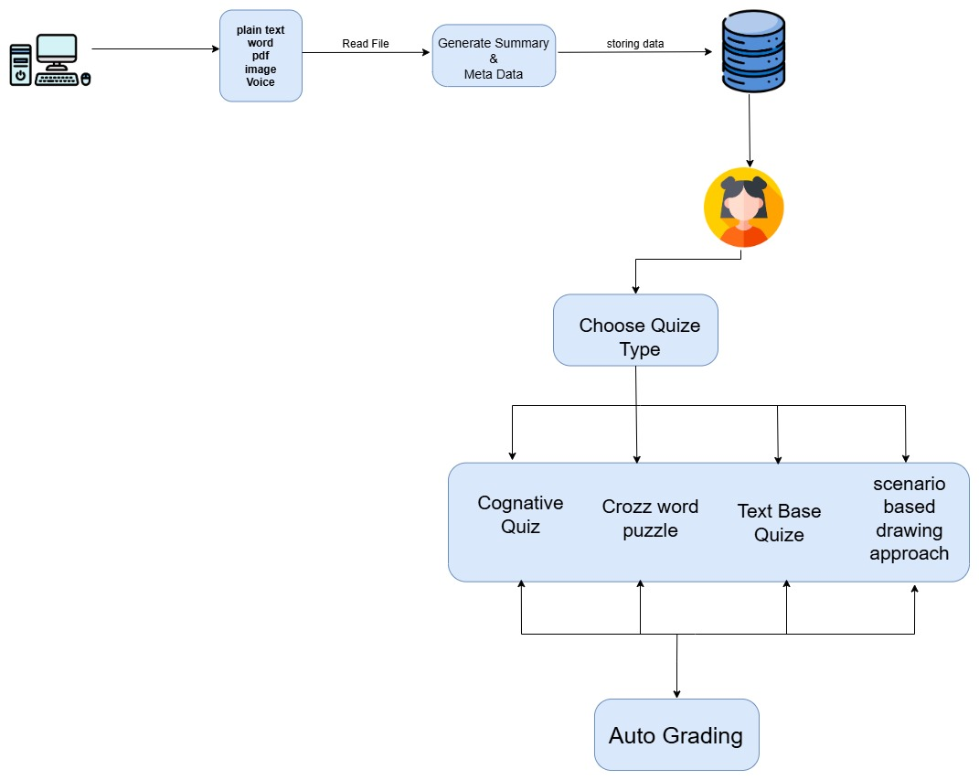
System Diagram
IT21277290 | Dulangi G.K.N | 24-25J-188

Slide 39
Progress and Deliverables
PP1 PP2
Retrieval-augmented generation (RAG) for content retrieval & metadata summary
MCQ-type quiz generation
Automatic marking schema creation and auto-grading
Cognitive quiz approach
Automated crossword puzzle generation
Scenario-based drawing approach
Content summarization
IT21277290 | Dulangi G.K.N | 24-25J-188

Slide 40
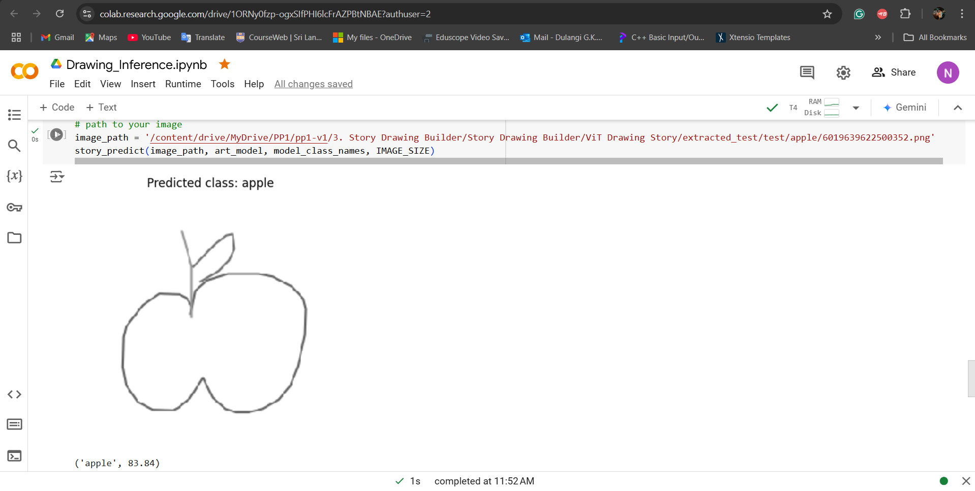
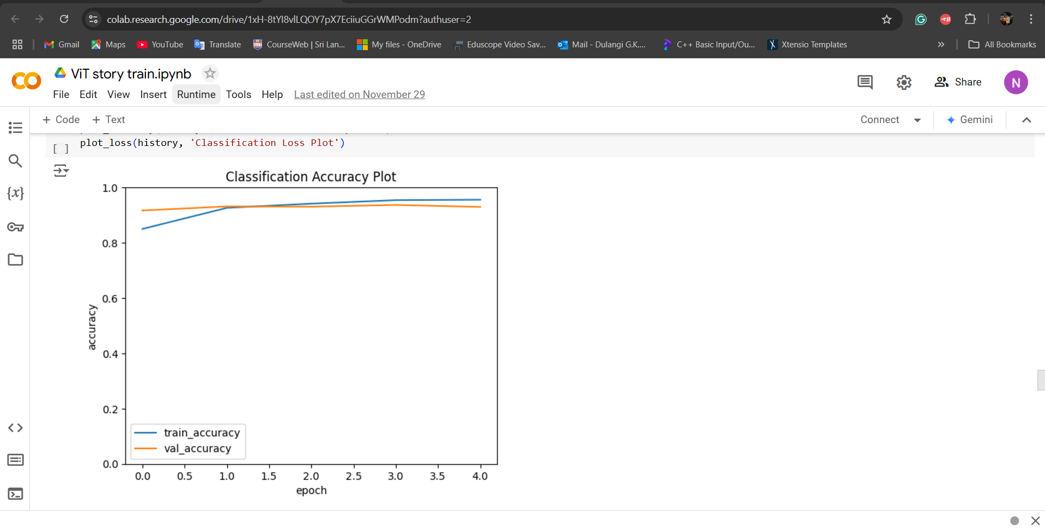
Proof of Concept
Accuracy of our model on train & test data
Predicted class of Scenario-based drawing approach
IT21277290 | Dulangi G.K.N | 24-25J-188

Slide 41
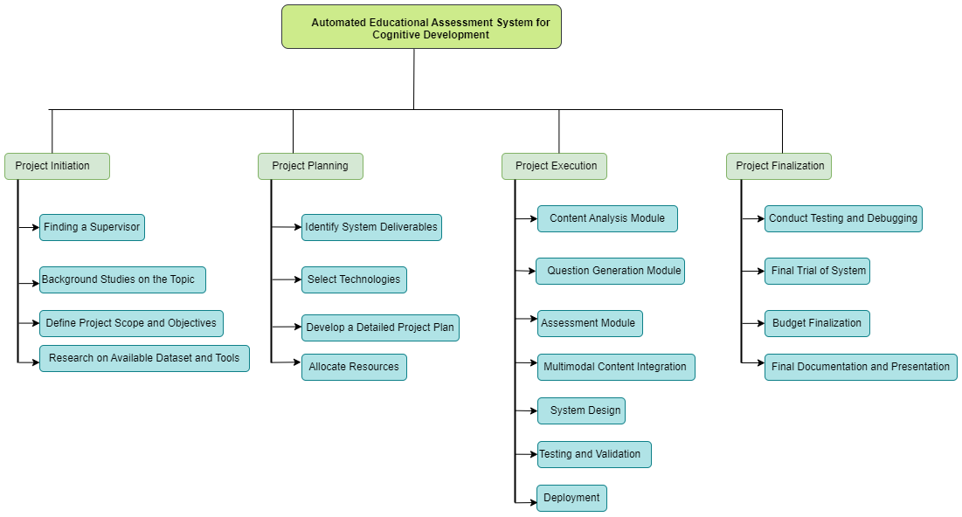
Work Breakdown Structure
IT21277290 | Dulangi G.K.N | 24-25J-188

Slide 42


Q&A SESSION

Slide 43


THANK YOU!

